Slide 1
FitLife
Isadora V

Slide 2
Intro
Atomic Habits
Small: at least 45min
Satisfying: 3 sessions/week = discount
Easy: can skip a week and still earn discount
Attractive: extra incentive for 4 weeks
 | Cumulative discount
1 week | 3%
2 weeks | 6%
3 weeks | 9%
4 weeks | 20%

Slide 3
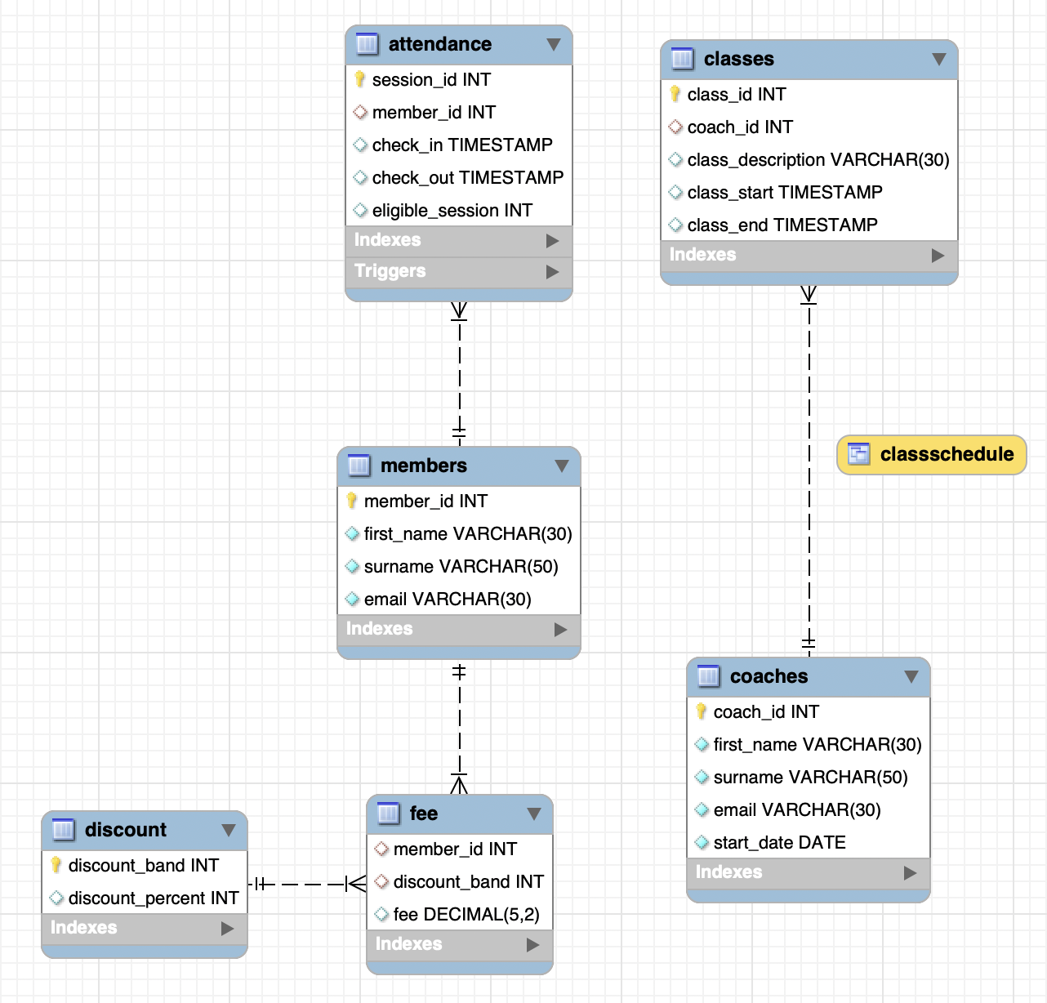
EER
Caption

Slide 4
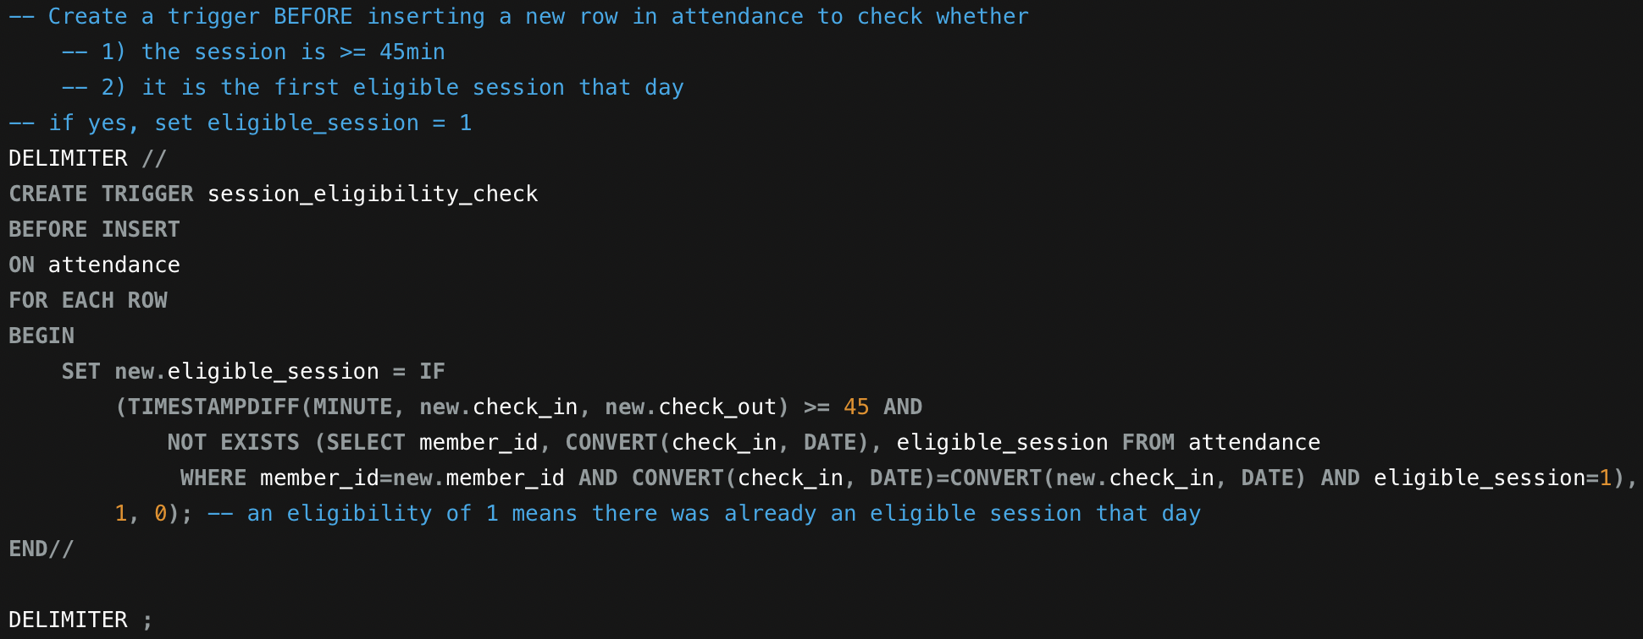
Trigger
Caption

Slide 5
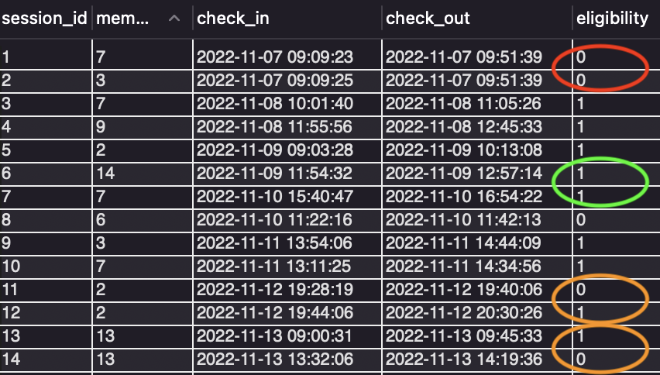
Trigger (sample output)
Caption

Slide 6
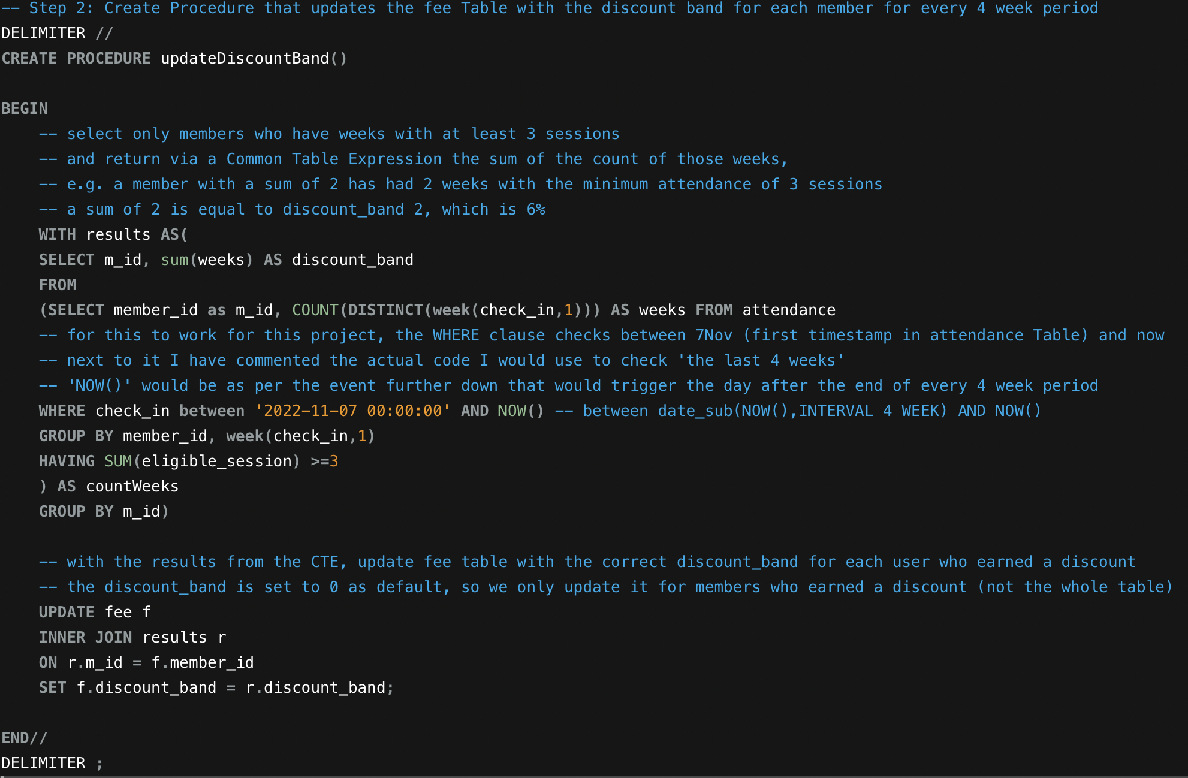
Stored Procedure
Caption

Slide 7
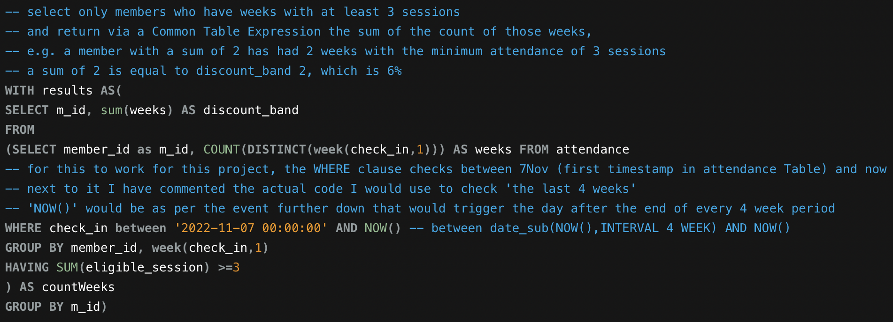
Sub query, Group By & Having
I have picked this sub query even though it is part of the previous stored procedure because it took me a long time to figure it out. I learned about CTEs in the process

Slide 8
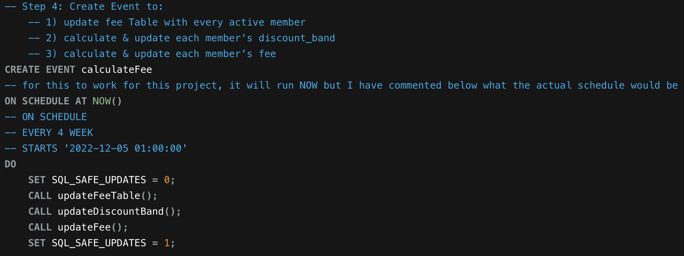
Event
Caption

Slide 9
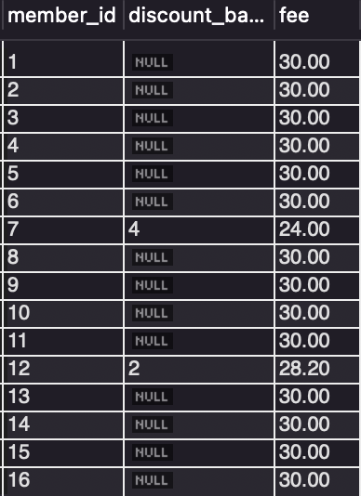
Event
Output after creating the event and running SELECT * FROM fee;
Only 2 members have earned discounts

Slide 10
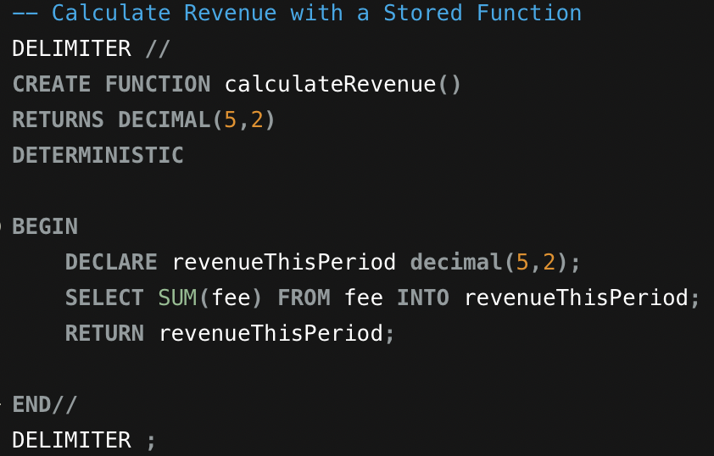
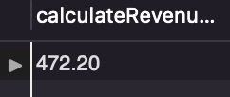
Stored Function
Output after running SELECT calculateRevenue();
Caption

Slide 11
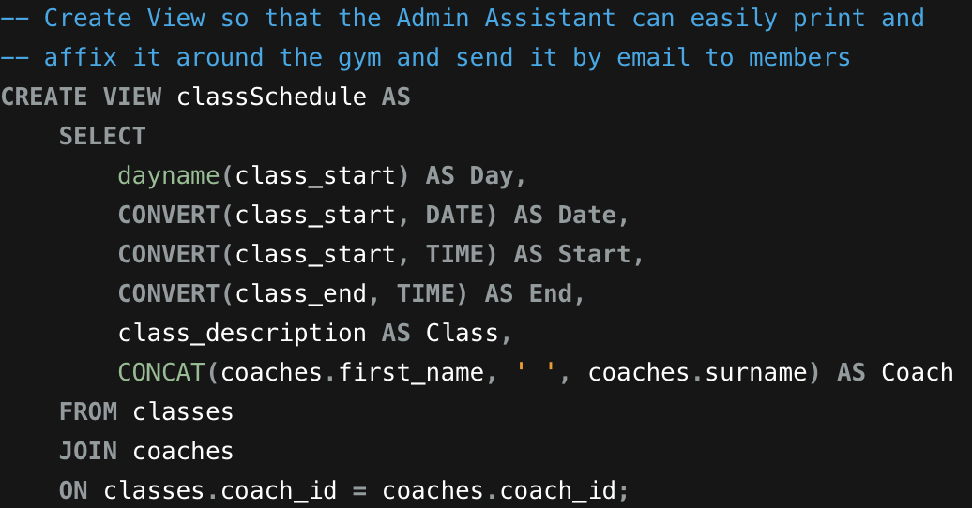
View (Class schedule)
Caption

Slide 12
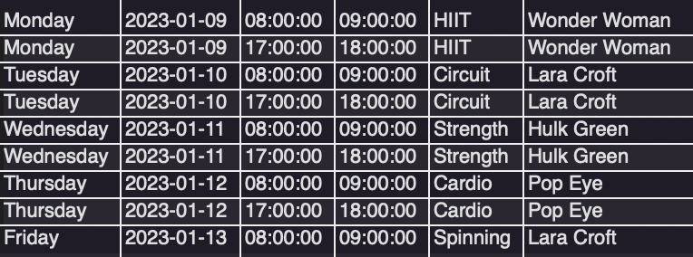
View (Class schedule)
Caption

Slide 13
LESSONS LEARNED!!!
DO NOT leave it till the last minute!!
Stop mySQL running when not using it!
Try out small portions of code to see if they work before adding on more
Save your code (multiple drops)
Google is your BEST friend!!!
Keep calm :)

